Slide 1
HbbTV: Reinventing the Broadcast TV UX presented by: Kirk Edwardson date: March 12, 2013

Slide 2
Agenda
Overview
Business Drivers
Adoption
Devices
Features
Services
Conclusion

Slide 3
HbbTV Overview
The HbbTV association is a global initiative aimed at providing an alternative to proprietary technologies and delivering an open platform for broadcasters to deliver on‐demand services to the end consumer
Formed in 2009 - aim to define an HTML-based specification to enable broadcasters to associate applications with their content, allowing consumers to access other video content and additional information.
In addition to helping consumers, the introduction of the HbbTV standard is of benefit to both equipment manufacturers and content providers.
Standards have historically been set on a country-by-country basis, requiring delivery of specialized hardware or content to each nation. The establishment of a unified HbbTV standard means content owners and application developers can write once and deploy across many countries.

Slide 4
HbbTV Business Drivers
Analog Switch Off and Move to Digital
Requires large countrywide investments
Often subsidized by governments or by selected broadcasters
Consumer Demand
More content, both free and paid
Better quality (HD) programming
New services such as VOD, Interactive TV, Information, games and more
Broadcaster Innovation
Interactive TV to attract consumers and retain their audience
New forms of advertising and revenue
Open content libraries to national/global audiences to build brand and new revenues
Government
New broadcast licenses
e-Government services
Education
Early warning systems
Show leadership in adopting advanced consumer TV services
Pay-TV Operators
Take advanced of open standard to replace legacy middleware cost-effectively
Support traditional value-add services for new revenue opportunities
Leverage HbbTV receivers (TV and set-top boxes) to deliver new services

Slide 5
HbbTV Adoption - Europe
in regular operation
announced / trials
no information
other plans

Slide 6
Worldwide Interest in HbbTV
Interest
trials
Interest
Last few weeks
ASBU (EBU for Arabic countries) is also adding HbbTV to its DTT recommendations
French speaking African countries as well
Australia – FreeView plus launched announced

Slide 7
HbbTV Devices Today & Tomorrow
Smart TV Manufacturers
All major global TV manufacturers are shipping with HbbTV support
Many smaller manufacturers are also shipping with HbbTV support
Support may be enabled on a per-country basis
Germany:
3.4M HbbTV TV sold in 2012
90% of the Connected TVs are HbbTV
France:
HbbTV TVs represent 55% of all TV references
Starting at 350€ retail price
Set-Top Box Manufacturers
A wide range of STB manufacturers are shipping models with HbbTV support
Available for satellite market in Europe with embedded CAS
Available for DVB-T2 Analog Switch Off in emerging markets
Limited extra cost between HD receivers and HD with HbbTV
Silicon Manufacturers
Broadcom, ST Microelecronics, ++

Slide 8
HbbTV Features – 1.0 & Beyond
HbbTV 1.0 Features
Playback of broadcast and IP-streamed media
Download media to persistent local storage
Access to channel list and now/next EPG data
Broadcast-related and broadcast-independent applications
HbbTV 1.5 Features
EIT-Schedule access
MPEG DASH
DRM APIs
Deployments: France on Terrestrial and Satellite / Spain on TDT Hibrida
All 2014 HbbTV deployments will be based on HbbTV 1.5
HbbTV association working on 1.5 test suite for interoperability purposes
HbbTV 2.0 Proposed Features
Improved support for HTML5
Companion screen app launching and synchronization Push VOD support
Improved support for ad insertion
Improved synchronization between media and applications.
Support for HEVC video
Improved support for MPEG DASH

Slide 9
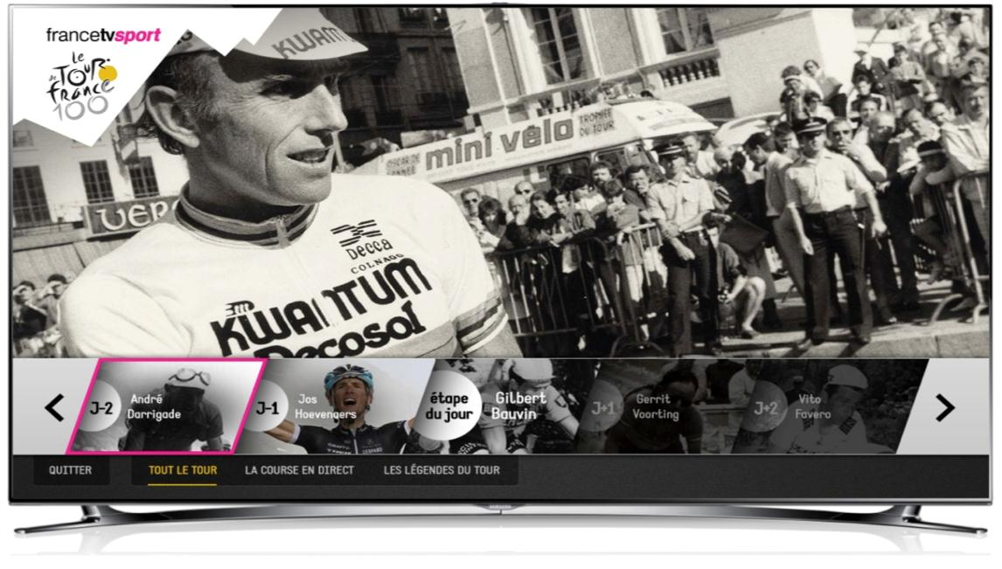
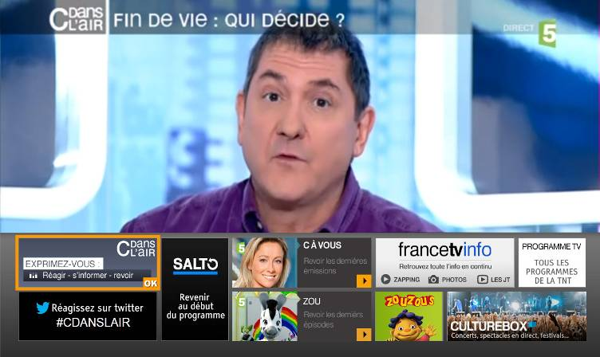
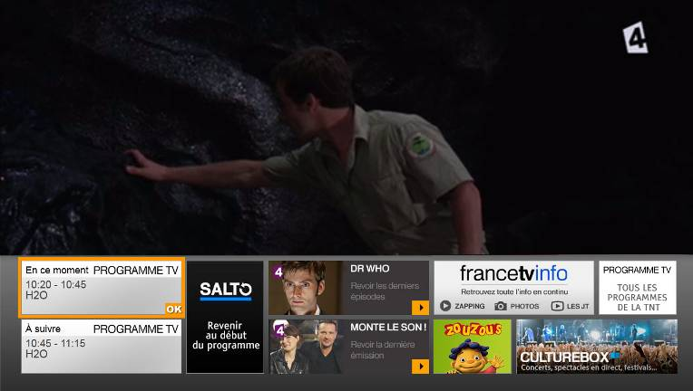
HbbTV Services & Apps
Examples: France Television
Video On Demand
Catch up
Start Over
Information services
News, weather, sports
eGovernment
Guide, EPG
Enhanced TV
Games
Education
Advertising
T-Shopping
TV portal
Companion screen
Easy access to multiple HbbTV services with OK button
EPG, Méteo, Salto, Player, ++
Available on each France Televisions channel
Banner is dynamic and contextual – based on channel, event, program, time

Slide 10
Conclusion
Strong momentum & growth
Exceptional viewing experiences
Connects strategies of broadcasters, consumer electronics manufacturers and pay-TV operators
LinkedIn group – very active, provides good view to HbbTV news
HbbTV: Reinventing the Broadcast TV UX

